Slide 1

Topic: Bivariate data
EQ: How is bivariate data interpreted when plotted in a scatterplot?
Instructions:
Read the instructions on slide 1
Complete the activity on slide slide 3
Complete the activity on slide slide 4 (this is your notes for this EQ)
Work through the example on slides 9-11. Try not to look at the solutions until you have had a go yourself
Complete the activity on slide 12-14
On slide 15 it asks you to complete the questions. Submit your work in the submission folder , “Term 1 Week 9 Lesson 4_ Interpreting scatterplots?”

Slide 2
Topic: Bivariate data
EQ: How is bivariate data interpreted when plotted in a scatterplot?

Slide 3
24
7
30
Date:
Bivariate Data
EQ: How is bivariate data interpreted when plotted in a scatterplot?
1. Watch the YouTube video on interpreting scatterplots: https://www.youtube.com/watch?v=PE_BpXTyKCE
2. Answer the following sentences in full sentences:
When sketching two variables on a scatterplot, what axis does the independent and dependant variables go? Why?
What are the 4 things you can talk about when you interpret a scatterplot?

Slide 4
24
7
30
Date:
Bivariate Data
EQ: How is bivariate data interpreted when plotted in a scatterplot?
Open up the “ Term 1 Week 9_Lesson 4_ Interpreting Scatterplots 3 ways” worksheet. This will be used to form your notes on this topic.
You will need to listen to the YouTube clip again and use the notes on slides 6-8 to fill in this worksheet.
Please note: On slide 5 you will see that I have completed the “direction “ notes for you. Now do the same for “form” and “strength”.

Slide 5
Direction | Form | Strength
POSITIVE RELATIONSHIP: If the data show an uphill pattern as you move from left to right e.g As the X-values increase (move right), the Y-values tend to increase (move up).
NEGATIVE RELATIONSHIP: If the data show a downhill pattern as you move from left to right eg As the X-values increase (move right) the Y-values tend to decrease (move down).
NO RELATIONSHIP: Hard to find a pattern showing a relationship between the variables.

Slide 6
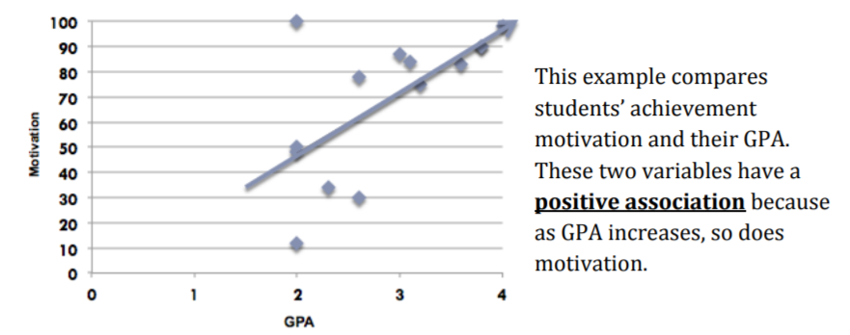
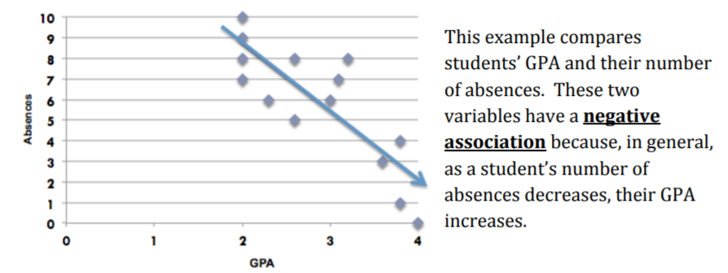
24
7
30
Date:
Bivariate Data
EQ: How is bivariate data interpreted when plotted in a scatterplot?
Direction Examples

Slide 7
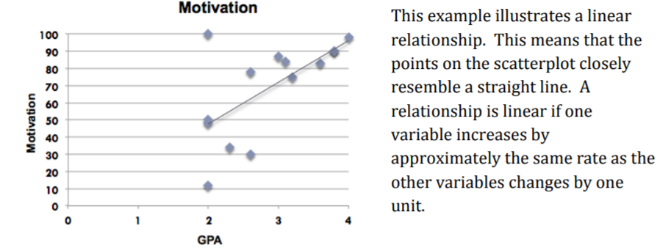
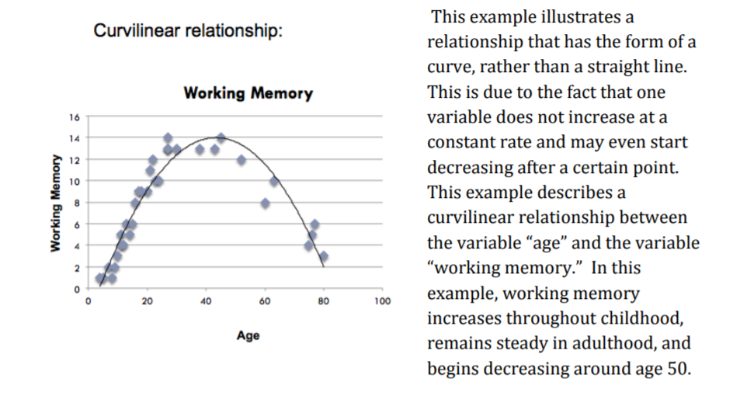
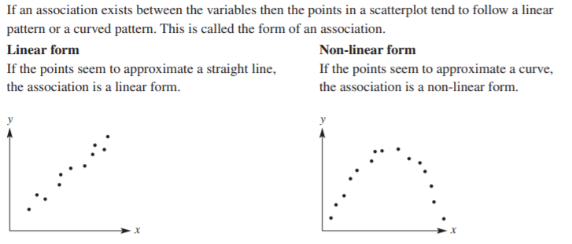
24
7
30
Date:
Bivariate Data
EQ: How is bivariate data interpreted when plotted in a scatterplot?
Form Examples

Slide 8
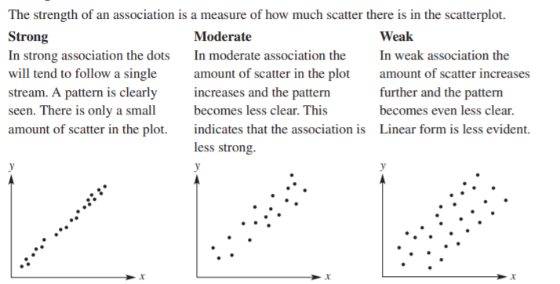
24
7
30
Date:
Bivariate Data
EQ: How is bivariate data interpreted when plotted in a scatterplot?
Strength Examples

Slide 9
24
7
30
Date:
Bivariate Data
EQ: How is bivariate data interpreted when plotted in a scatterplot?
EXAMPLE
An example of bivariate data that you may encounter is the “number of drinks sold at the school canteen” and the “daily temperature”
Daily Temperature (Cº) | Drinks sold
18 | 160
22 | 200
24 | 250
33 | 450
30 | 430
28 | 300
29 | 360
17 | 150
23 | 230
27 | 250
Does it look like the number of drinks sold is affected by the temperature?

Slide 10
24
7
30
Date:
Bivariate Data
EQ: How is bivariate data interpreted when plotted in a scatterplot?
Here is the scatterplot of the data form the previous slide
As the daily temperature (x-axis) increases, does the amount of drinks sold increase (y-axis)?

Slide 11
24
7
30
Date:
Bivariate Data
EQ: How is bivariate data interpreted when plotted in a scatterplot?
The overall pattern of a scatterplot can be described by the:
direction, form, and strength of the relationship.
How would you describe this scatterplot?
Strong or Weak?
Linear or Not?
Positive or Negative?
Our graph is a strong, positive graph, that is almost linear.

Slide 12
Your turn
Sam’s Mum wants to buy a new Golf. She looks on “Gumtree” and makes a list of how many years old the car is, and the sale price.
Number of years old
0
1
2
3
5
6
7
8
9
11
Cost of car ($)
32000
29500
24500
20,000
16500
14500
13000
10900
10500
7500
Make a scatterplot of the data, and describe the trend

Slide 13
ANSWERS
Sam’s Mum wants to buy a new Golf. She looks on “Gumtree” and makes a list of how many years old the car is, and the sale price.
Number of years old
0
1
2
3
5
6
7
8
9
11
Cost of car ($)
32000
29500
24500
20,000
16500
14500
13000
10900
10500
7500
Which variable is the;
Independent
- Number of years old
Dependent
- Cost of the car
Make a scatterplot of the data, and describe the trend

Slide 14
Car data Scatter plot
ANSWERS
We can see that the lower the years on the car, the more expensive it is to buy.
The trend is very linear, and negative. The dots form almost a straight line, so the correlation could be classified as strong.

Slide 15
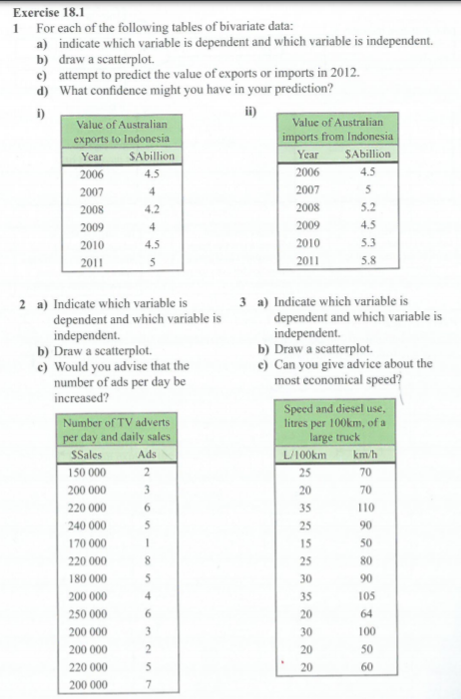
Your turn: Submit this work in the submission folder

